Slide 1
Project Presentation of Back End Engineering Project (BEE) (22CS026)
On
Travel-Ease Prerna Sharma
2210992086
Priya
2210992095
Supervised By
Mr. Rahul Singh Rajput
Department of Computer Science and Engineering
Chitkara University, Punjab

Slide 2

TRAVEL-EASE : TRAVEl WORLD
It’s Time To Travel The World

Slide 3
TABLE OF CONTENTS
Introduction
Abstract
Problem Statement
Software Development Life Cycle Diagram
Technical Details
Key Features
Future scope
Conclusion
References/Links used

Slide 4
INTRODUCTION
In today's fast-paced world, managing travel plans and tours can be a daunting task.
A well-organized tour management website can streamline this process, making it easier for users to plan, book, and manage their travel experiences.
This project involves developing a full-stack tour management website that will serve as a one-stop solution for travelers and tour operators.
The website will integrate both front-end and back-end technologies to provide a seamless and interactive user experience.

Slide 5
ABSTRACT
The tour management website aims to create an efficient platform for users to browse, book, and manage tours and travel itineraries. The website will feature a user-friendly interface for customers to search for destinations, view tour packages, and make bookings. On the backend, the system will handle user authentication, payment processing, and database management. The project utilizes modern web technologies to deliver a responsive and scalable application that caters to both tourists and tour operators.

Slide 6

PROBLEM STATEMENT
Planning and managing tours can be time-consuming and complex due to the need for coordinating multiple elements such as travel dates, destinations, accommodations, and activities. Existing solutions often lack integration, making it difficult for users to find and book tours that fit their preferences. The goal of this project is to develop a comprehensive tour management system that simplifies the tour planning process, offers personalized recommendations, and ensures a smooth booking experience.

Slide 7
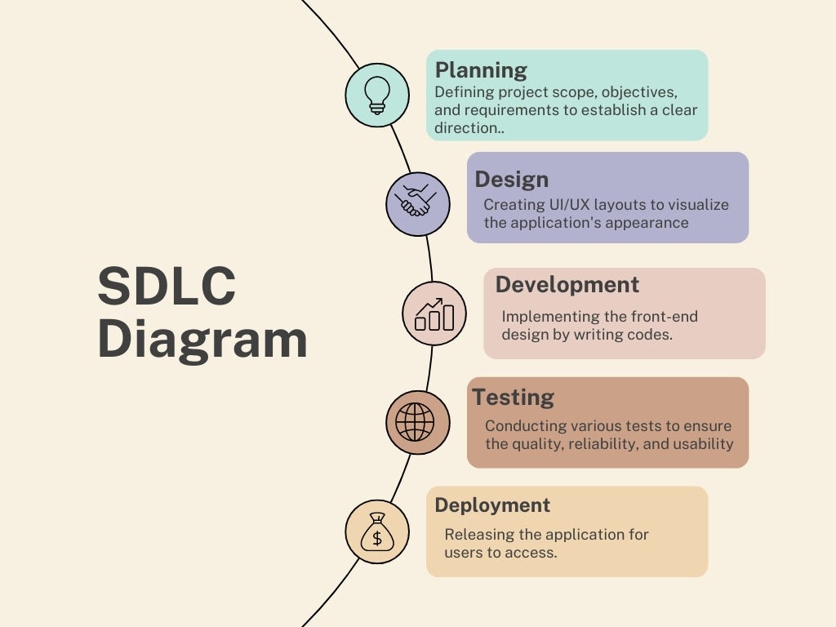
SDLC MODEL

Slide 8



TECHNICAL DETAILS
HTML:
Markup language for creating the structure of web pages.
Utilizes elements like <div>, <p>, <img> to organize content.
Forms for user input, with various input types like text, password, etc.
Semantics for accessibility and SEO.
CSS:
Style sheet language for styling HTML elements.
Box model for layout: content, padding, border, margin.
Selectors and specificity for targeting elements.
Layout techniques like positioning, display, flexbox, and grid.
Responsive design with media queries.
React JS:
Utilized for building the frontend user interface.
Component-based architecture for modularity and reusability.
Virtual DOM for efficient rendering and performance optimization.
Ensured compatibility across various devices and screen sizes

Slide 9


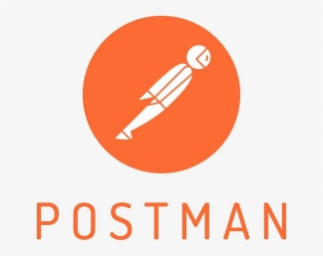
TECHNICAL DETAILS
Backend
MongoDB:
MongoDB is a source-available, cross-platform, document-oriented
database program.
MongoDB utilizes JSON-like documents with optional schemas.
MongoDB is developed by MongoDB Inc.
Express:
Express is a minimal and flexible Node.js web application framework
that provides a robust set of features for web and mobile applications.
Express is a lightweight and flexible routing framework with minimal
core features meant to be augmented through the use of Express middleware modules.
Postman:
Postman is a global software company that offers an API platform for developers to design, build, test, and collaborate on APIs.

Slide 10

KEY FEATURES
User Authentication:
Secure user authentication system allowing users to register, log in, and manage their accounts.
Tour Search and Filtering:
Search tours by destination, date, and preferences
Booking System:
Online booking with real-time availability
Payment processing integration
Tour Management Dashboard:
Admin interface for managing tour listings, bookings, and user accounts
Responsive Design:
Mobile-friendly layout for accessing the website on various devices

Slide 11

FUTURE SCOPE
Integration of AI for Personalization:Implement AI algorithms to offer personalized tour recommendations based on user preferences and past behavior.
Multi-language Support: Expand the website’s reach by providing multiple language options for international users.
Mobile Application: Develop a companion mobile app to offer on-the-go access to tour management features.
Enhanced User Experience: Incorporate virtual reality (VR) or augmented reality (AR) features to provide virtual tours of destinations.
Advanced Analytics: Use data analytics to provide insights into user behavior and optimize marketing strategies.

Slide 12

CONCLUSION
“The development of a tour management website will provide users with a comprehensive platform to efficiently plan, book, and manage their travel experiences. By integrating modern web technologies and adhering to best practices in software development, the project aims to deliver a seamless and user-friendly experience. With the potential for future enhancements, the website can evolve to meet the growing demands of the travel industry”

Slide 13
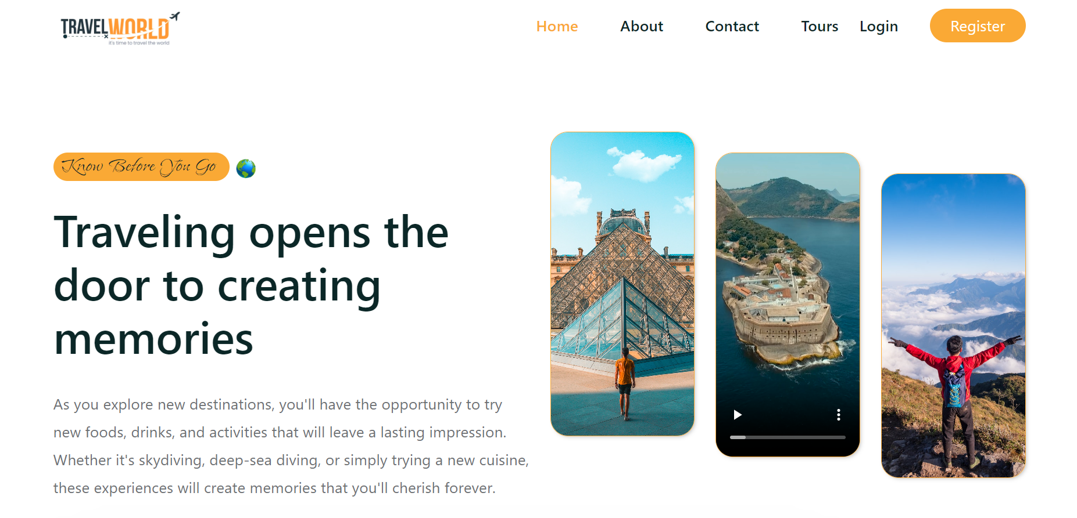
SNAPSHOTS
HOME PAGE :

Slide 14
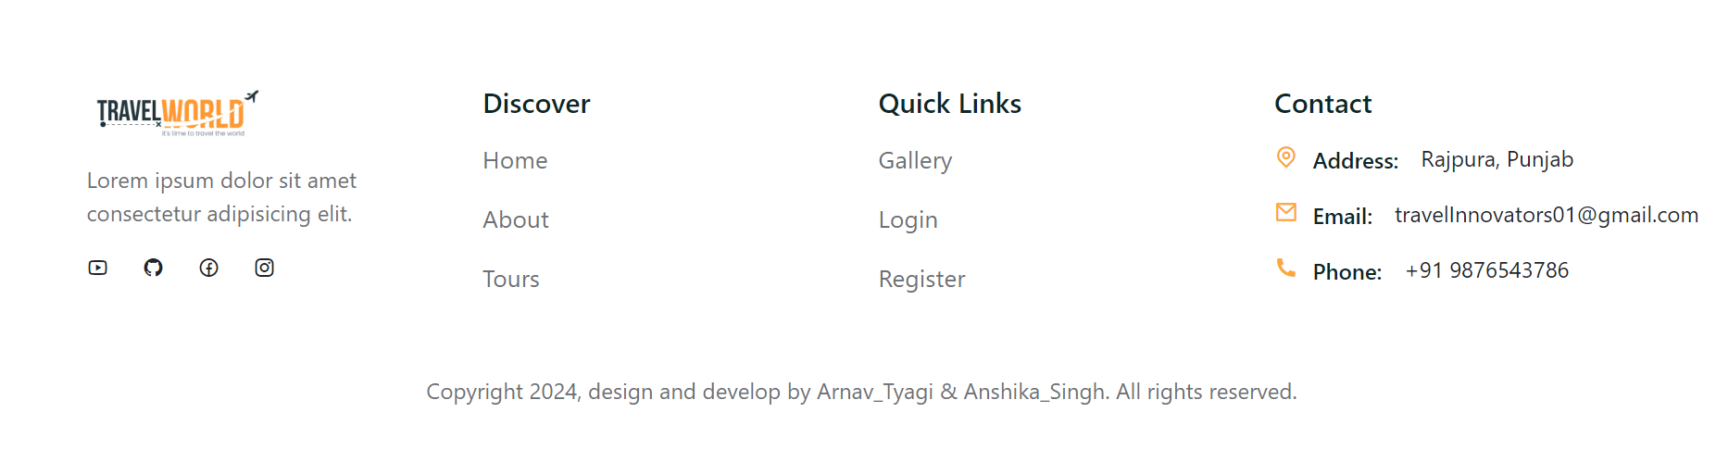
SNAPSHOTS
HEADER OF THE PAGE:
FOOTER OF THE PAGE:

Slide 15
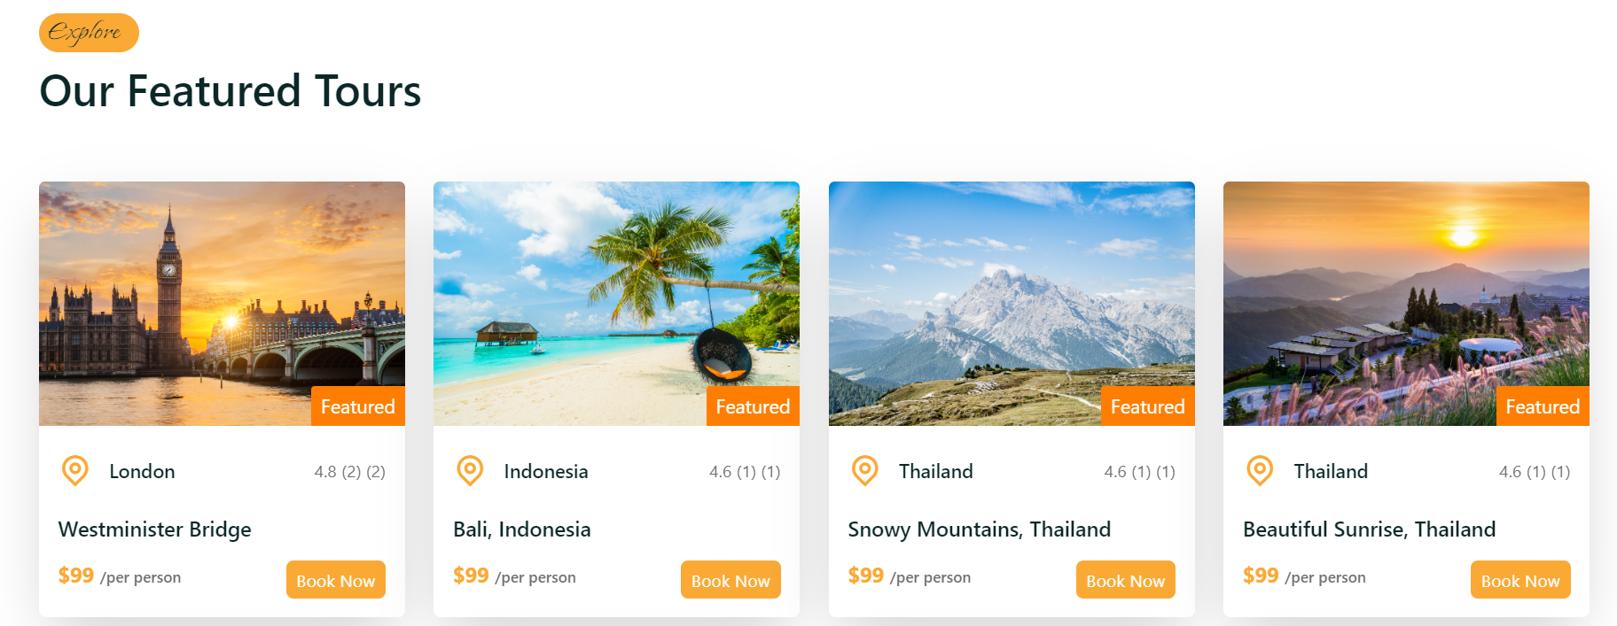
SNAPSHOTS
FEATURED-TOURS :

Slide 16
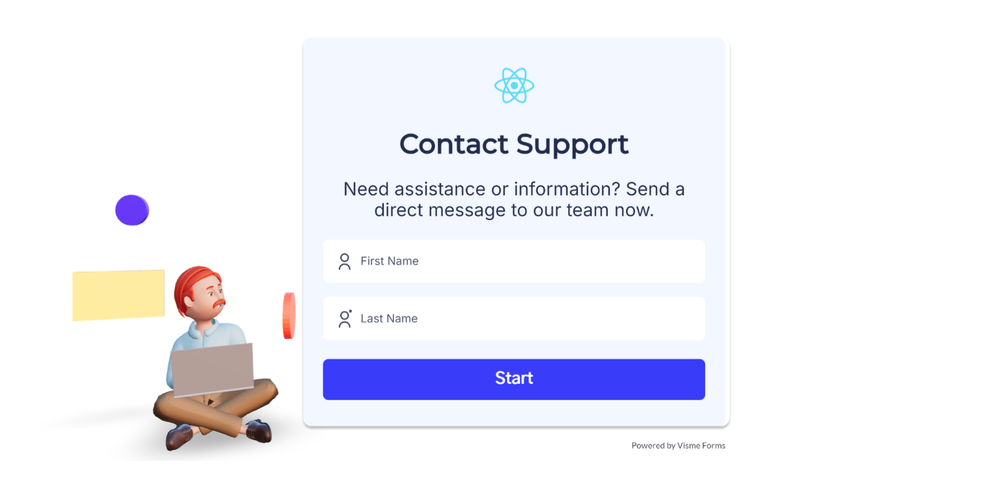
SNAPSHOTS
Contact Us :

Slide 17
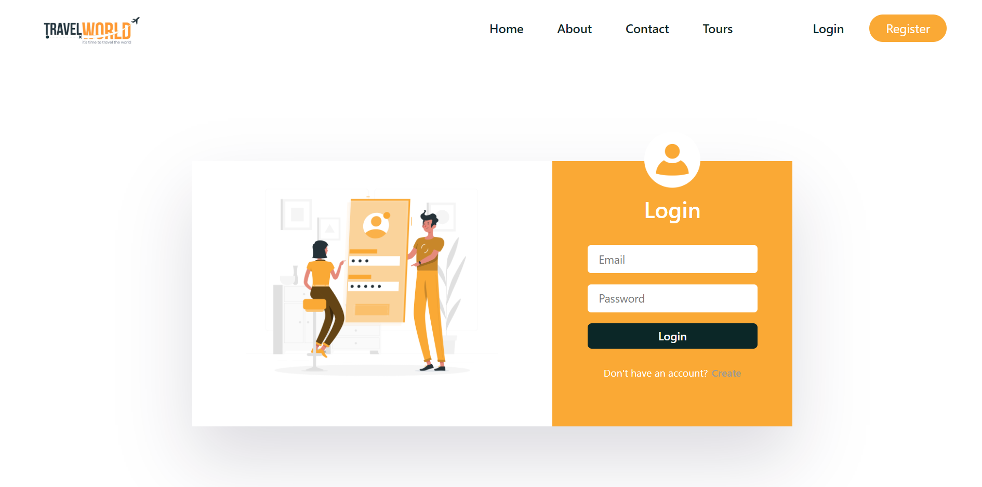
SNAPSHOTS
Login Page:

Slide 18
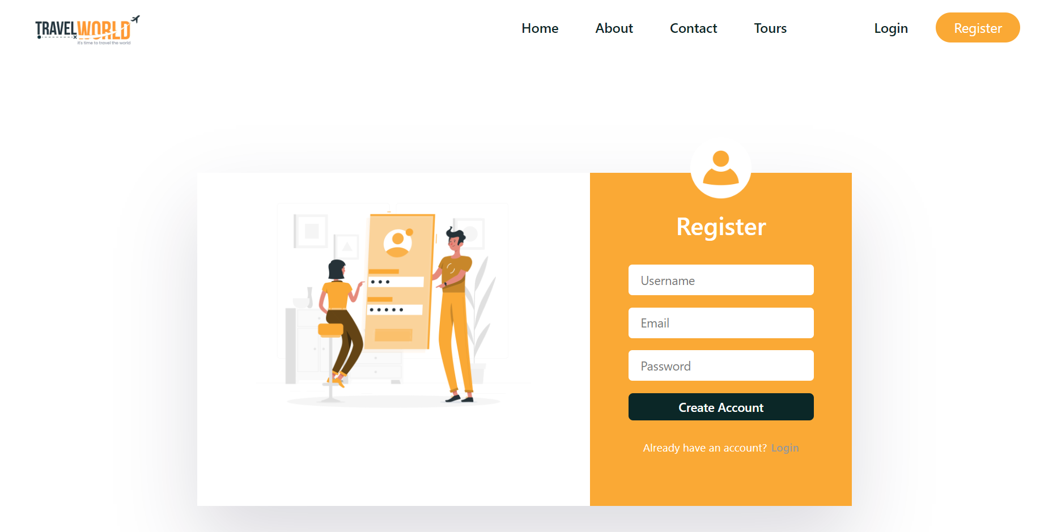
SNAPSHOTS
Sign Up Page:

Slide 19
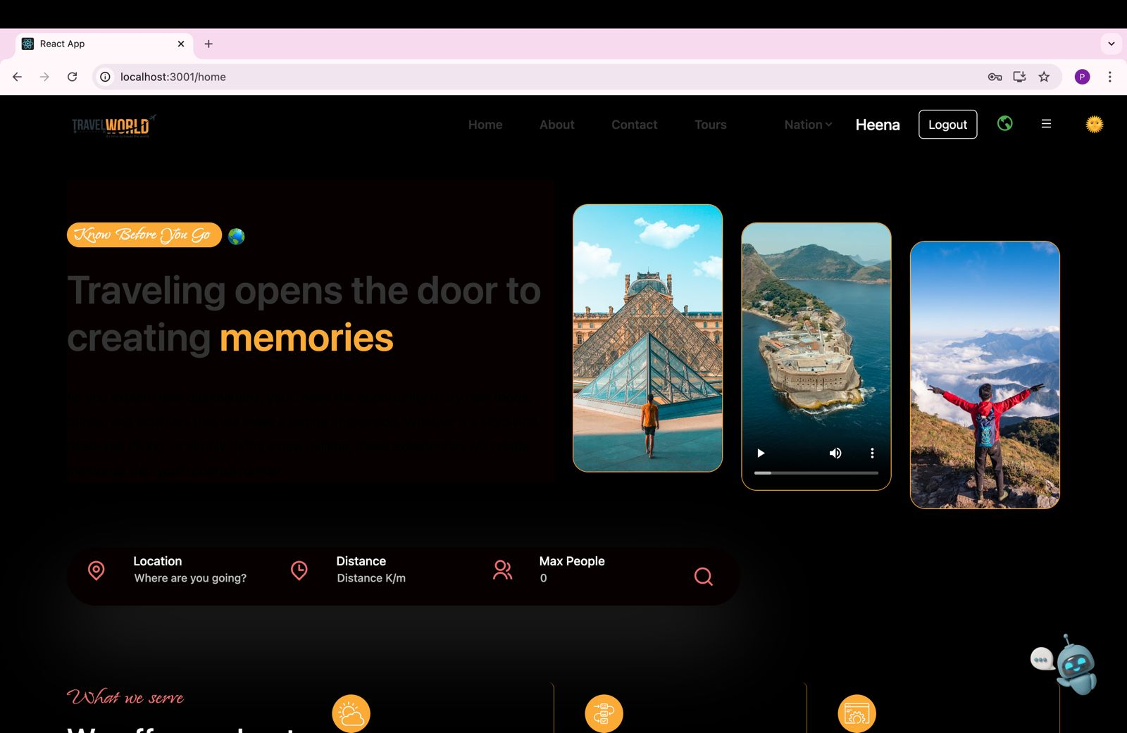

Slide 20
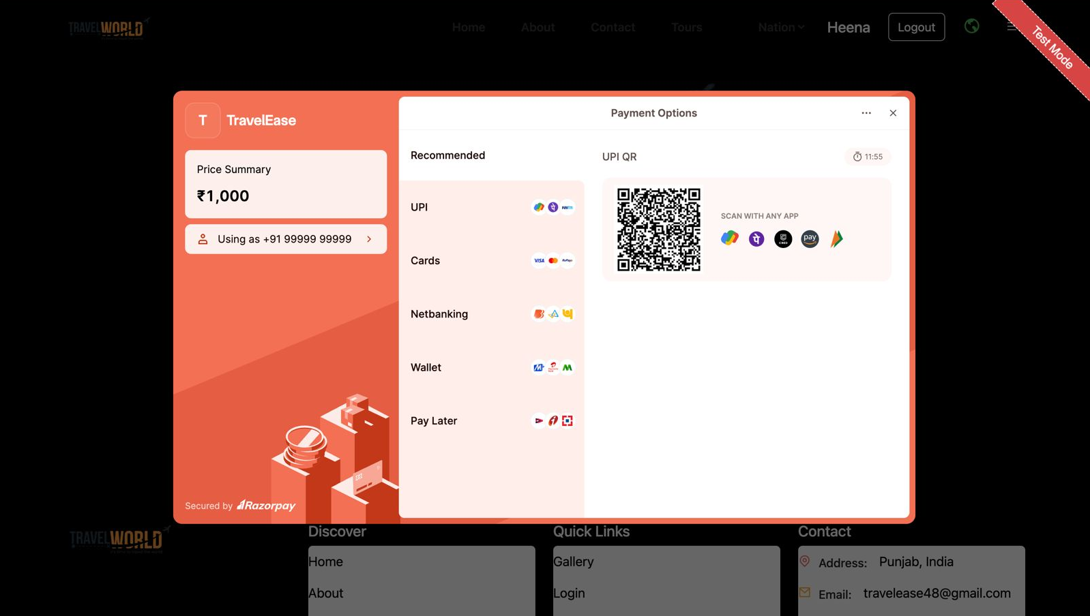

Slide 21
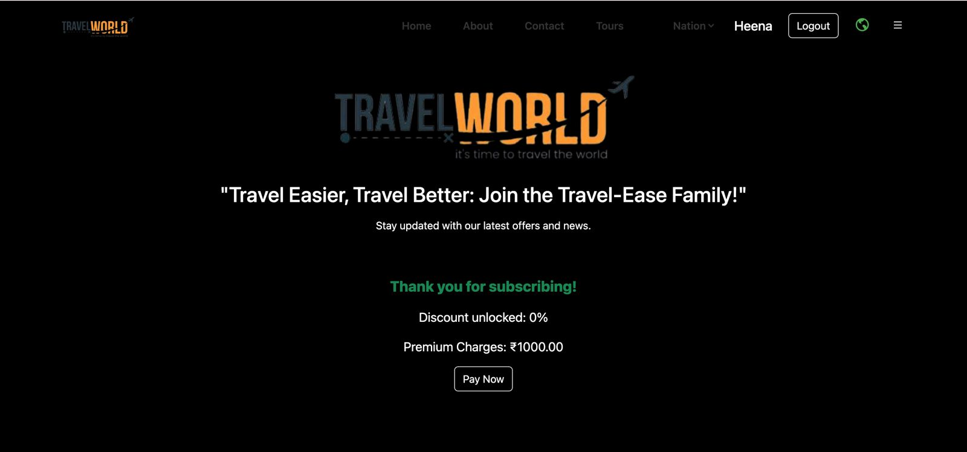

Slide 22
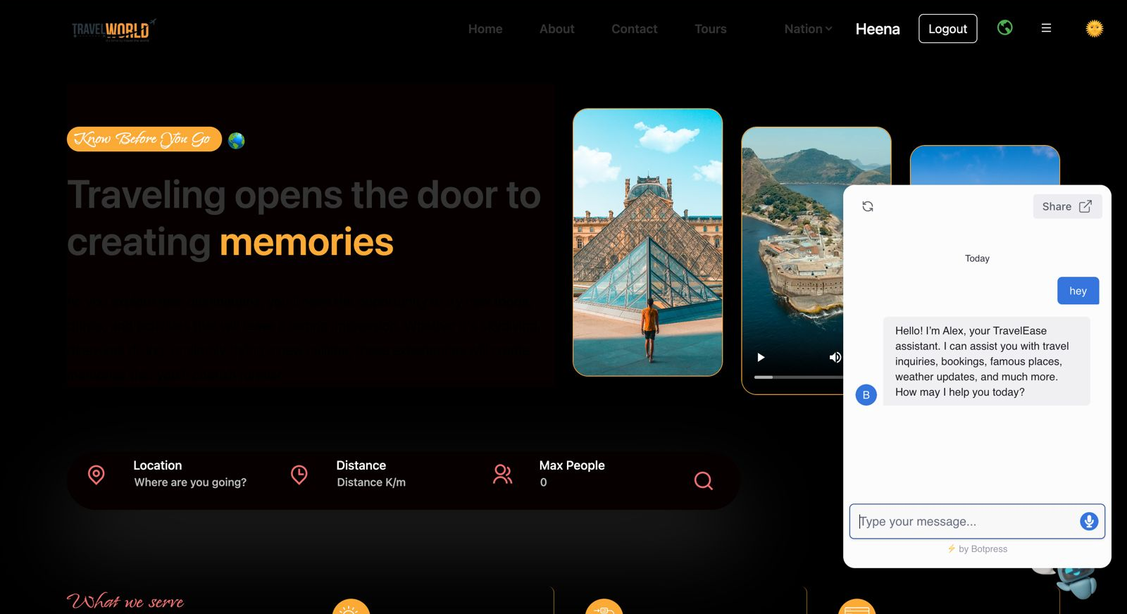

Slide 23
References/Links used:
https://unsplash.com/
https://google.com/
https://youtube.com/
https://github.com/
https://www.makemytrip.com/

Slide 24


